Slide 1
Electricity
Static Electricity
Current
Voltage
Resistance
Energy and Power
Circuits
Electrical energy sources
Alternating current
Household Electricity

Slide 2

SCSA ATAR Syllabus (up to date as of 14/11/17; https://senior-secondary.scsa.wa.edu.au/syllabus-and-support-materials/science/physics)
Science Understanding
there are two types of charge that exert forces on each other
electric current is carried by discrete charge carriers; charge is conserved at all points in an electrical circuit This includes applying the relationship $I=\frac{q}{t}$
energy is conserved in the energy transfers and transformations that occur in an electrical circuit
the energy available to charges moving in an electrical circuit is measured using electric potential difference, which is defined as the change in potential energy per unit charge between two defined points in the circuit This includes applying the relationship $V=\frac{W}{q}$
energy is required to separate positive and negative charge carriers; charge separation produces an electrical potential difference that drives current in circuits
power is the rate at which energy is transformed by a circuit component; power enables quantitative analysis of energy transformations in the circuit This includes applying the relationship $P=\frac{W}{t}=VI$
resistance depends upon the nature and dimensions of a conductor
resistance for ohmic and non-ohmic components is defined as the ratio of potential difference across the component to the current in the component This includes applying the relationship $R=\frac{V}{I}$
circuit analysis and design involve calculation of the potential difference across the current in, and the power supplied to, components in series, parallel, and series/parallel circuits This includes applying the relationships
series components, $I=constant$ $V_{t}=V_{1}+V_{2}+V_{3}…$ $R_{t}=R_{1}+R_{2}+R_{3}…$ parallel components, V$=constant$ $I=I_{1}+I_{2}+I_{3}…$ $\frac{1}{R_{t}}=\frac{1}{R_{1}}+\frac{1}{R_{2}}+\frac{1}{R_{3}}…$
there is an inherent danger involved with the use of electricity that can be reduced by using various safety devices, including fuses, residual current devices (RCD), circuit breakers, earth wires and double insulation
electrical circuits enable electrical energy to be transferred and transformed into a range of other useful forms of energy, including thermal and kinetic energy, and light
Science as a Human Endeavour
The supply of electricity to homes has had an enormous impact on society and the environment. An understanding of electrical circuits informs the design of effective safety devices for the safe operation of:
lighting
power points
stoves
other household electrical devices.

Slide 3

Static Electricity
A stationary build up of charge on the surface of an insulator
Electric charge is measured in Coulombs (C)
$−1C≈\text{the} \text{charge} \text{of} 6.25×{10}^{18}$electrons
Caused by an excess or deficit of electrons
Created by rubbing two different insulators together; charging by friction
Different materials attract electrons with different strengths, whichever material pulls more strongly on electrons will take electrons from the other, becoming negatively charged and leaving the other positively charged

Slide 4
Electrostatic interactions
Like charges repel, opposite charges attract
Charged objects weakly attract uncharged objects; induction
Particle now has a dipole; 1 +ve end and one –ve end, +ve end attracted to –ve rod
neutral
Negative charge repels electrons
-
-
+
+
-
+
-
+
-
-
+
-
+
+
-
+
-
-
Negatively charged due to excess electrons
+
+
-
- - - - - - - - - -
-
-
-
+
+
+
+
-
-
+
+
-
-
-
-
+
+
+
+
-
-
+
+
-
-
+
+
+
-
-
+
-
+
-
+

Slide 5
Electroscopes
+
+
+

Slide 6
Electroscopes
-
-
-

Slide 7
Grounding
The ground functions as an infinite sink for/source of electrons to neutralise static charges
A positively charged object can replenish its electrons from the ground
A negatively charged object can disperse its excess electrons to the ground
Connecting an object to the ground with a conductor prevents a static charge from building up on the object

Slide 8
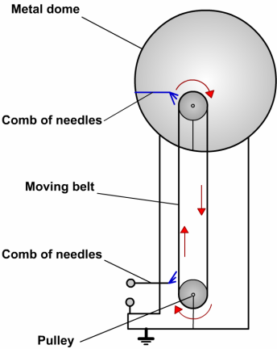
Van der graaf generator
Comb at base rubs against belt stripping electrons and dispersing them to the earth
Comb at top replenishes electrons on the belt, taking them from the metal dome leaving the dome positively charged
As this continues, very large positive charges can build up on the metal dome

Slide 9

Current electricity
Flow of charge through a conductor (normally flow of electrons but can be ions)
Current is measured in Amperes or Amps (A)
1 A is equivalent to 1C of charge flowing through a point in 1s
1 A$≈6.25×{10}^{18}$ electrons flowing through a point each second

Slide 10

$$I=\frac{q}{t}$$
$I=\text{current}\text{ (}\text{A}\text{)}$
$q=\text{charge}\text{ (}\text{C}\text{)}$
$t=\text{time}\text{ (}\text{s}\text{)}$

Slide 11

Example
Determine the charge that flows through a torch in 20 minutes while 300mA of current is flowing.
$$q=It$$
$$q=0.3×20×60$$
$$q=360C$$
How many electrons passed through the torch filament in this time?
$$\#_{electrons}=\frac{charge}{charge of an electron}$$
$$\#_{electrons}=\frac{360}{1.6×{10}^{−19}}$$
$$\#_{electrons}=2.25×{10}^{21}$$

Slide 12
Direction of current
Conventional current
Electron flow
The direction a positive charge would move
Used by electrical engineers
1-way circuit components (diodes) have their circuit diagram symbols point in this direction
Flow of positive charge from the positive terminal to the negative terminal
Flow of electrons from the negative terminal to the positive terminal
What actually occurs in metal wire circuits

Slide 13

Voltage/Potential difference/electromotive force
related concepts all measured in Volts
$$V=\frac{W}{q}$$
$$1V=1JC^{−1}$$
$$−1C≈\text{the} \text{charge} \text{of} 6.25×{10}^{18} electrons$$
$$1V≈1J \text{per} 6.25×{10}^{18} electrons$$
Volts measure the amount of potential energy held by/lost by the electrons in a circuit
Potential difference measures the amount of potential energy lost by electrons as they pass through a circuit component
Electromotive force (emf) measures the amount of potential energy provided to electrons by a source of electrical energy, can also be referred to as potential difference (it is not a force at all)

Slide 14

Example
The alternator of a car being driven at night with headlights on is producing 50A of current and an emf of 12 V.
A) How many coulombs of charge flow in 1 second?
$$50C$$
B) How many joules of energy does each coulomb obtain?
$$12J$$
C) how many Joules of energy does the alternator produce each second?
$$W=Vq=12×50=600J$$
D) Where does the energy go?
Transformed by the headlights into light, heat and sound energy

Slide 15

Resistance
Measure of the difficulty of passing a current through a conductor, measured in Ohms (Ω)
Analogous to friction
Superconductors have a resistance of 0Ω, only at low temperatures ($≤$-70$℃$)

Slide 16

Factors affecting resistance
$$R=\frac{ρL}{A}$$
$ρ$ = resistivity, material specific (Ω m)
L = length (m)
A = cross-sectional area (m²)
Also temperature dependent; low T = low R
Running a current through a conductor causes it to heat up; the longer current flows the greater the resistance

Slide 17

Example
A power cabling consists of 3 separate and insulated wires. Each wire is 1.00 mm in diameter. It’s resistivity is 1.72 x 10⁻⁵ ohm m.
Calculate the resistance of each wire if the cable is 25m long.
$$R=\frac{1.72×{10}^{−5}×25}{π{0.0005}^{2}}=547Ω$$
Determine the resistance of the same wire if the diameter was doubled.
$$R=\frac{1.72×{10}^{−5}×25}{π{0.001}^{2}}=137Ω$$

Slide 18

Ohm’s Law
$$I=\frac{V}{R}$$
Only true for certain materials at constant T, these are known as ohmic conductors
Key to most electricity calculations
Lightbulbs are non-ohmic conductors but may behave as ohmic conductors at low voltages

Slide 19
Ohm’s Law graph (ohmic conductor)
An applied voltage causes a current so voltage should plot on the x-axis
However, if equation is rearranged to V=IR and voltage is plotted on the y-axis, then the gradient is the resistance which is convenient
Here a gradient of 1 is observed so the graph shows the relationship between voltage and current for a 1 Ω resistor

Slide 20

Ohm’s Law graph (non-ohmic conductor)
A non-linear relationship is observed
Resistance is current dependent
Resistance can still be determined but only for a specified current
Draw in a straight line tangential to the curve, find the gradient of the tangent
Resistance at 8 A
$$R=\frac{ΔV}{ΔI}=\frac{20000−0}{16−6}=2000Ω$$

Slide 21

Calculations
Determine the resistance in a piece of resistance wire if the current is 250 mA when a PD of 6 V is applied.
$$R=\frac{V}{I}=\frac{6}{0.25}=24Ω$$
Determine the current flowing through a 60 ohm resistor when the PD is 12V.
$$I=\frac{V}{R}=\frac{12}{60}=0.2A$$
Determine the PD if 0.6A flows through a 350 ohm resistor.
$$V=IR=0.6×350=210V$$

Slide 22

Electrical Energy
Potential Difference is the work done per unit charge
$$W=Vq$$
Recall that:
$$q=It$$
By substitution can derive:
$$W=VIt$$
$$W= \text{work}\text{ (}\text{Joules}\text{, }\text{J}\text{)}$$

Slide 23

Example
Electrons in a TV tube are accelerated through a potential difference of 2.00kV. Mass of e- = 9.11 x 10⁻³¹ kg
Calculate:
Work done on each electron
$$W=Vq=2000×1.6×{10}^{−19}=3.20×{10}^{−16}J$$
KE of an electron
Assuming electrons started at rest: $3.20×{10}^{−16}J$
Final velocity of electrons assuming initially at rest.
$$KE=\frac{1}{2}mv^{2}=3.20×{10}^{−16}=\frac{1}{2}9.11×{10}^{−31}v^{2}$$
$$v=2.65×{10}^{7}m s^{−1}$$

Slide 24

Example 2
How long does it take a piece of resistor wiring to heat 100mL of water from 20⁰C to 90⁰C if the potential difference across the resistor is 24V and the current flowing is 4.00 A. Assume no heat lost to the surroundings.
$$VIt=mc∆T$$
$$24×4t=0.1×4180×70$$
$$t=305s$$

Slide 25

Electrical Power
Power is the rate at which work is done or energy is transformed
$$P=\frac{W}{t}$$
Recall that:
$$W=VIt$$
By substitution can derive:
$$P=VI$$
$$P= \text{power}\text{ (}\text{Watts}\text{, }\text{W}\text{, }\text{J} \text{s}\text{−1}\text{)}$$

Slide 26

Example
1) A headlamp is rated 12 V and 5 A, what is it’s power?
$$P=VI=60 W$$
2) Bulbs are rated: 2.8V, 0.27A and 4.2V , 0.18A
$$P=2.8×0.27=0.756 W$$
$$P=4.2×0.18=0.756 W$$
Which will be the brightest?
Both the same brightness
Could they be interchanged?
no

Slide 27

Other derived equations for Power
$$P=I^{2}R$$
Use this eqn for heat released from appliance/wiring.
Heating effect
$$P=\frac{V^{2}}{R}$$
To gain more power must R be increased or decreased?
Decrease R, so the current increases having an increase in power as is squared.

Slide 28

example
A car’s headlights are rated at 50.0W and operate on 12.0V. Calculate:
Current flowing in each headlight
$$I=\frac{P}{V}=\frac{50}{12}=4.17A$$
Charge passing through each globe every second.
$$4.17C$$
Total energy consumed by 2 headlights during a 2 hour night journey.
$$E=VIt=2\left(12×4.1\dot{6}×2×60×60\right)=7.20×{10}^{5}J$$

Slide 29
Electric Circuits
A circuit is a path where a current can flow
If the flow is to be continuous, there can be no gaps in the path
Introduce gaps in the form of switches, so we can control completing a circuit
Most circuits have more than one device that we want to provide with electrical energy

Slide 30
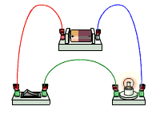
Circuit Diagrams
Drawn using straight lines for wires, right angle corners
Specific symbols for circuit components

Slide 31
Component Symbols
Wire
Open switch
Closed switch
Cell
Battery
AC power supply
Earth
Lamp
Lamp
Resistor
Resistor
Variable resistor
Diode
Ammeter
Voltmeter
Ohmmeter
A
V
Ω

Slide 32
Electric Circuits
There are two ways to connect multiple devices to a voltage source
One is called series
The other is called parallel
Each has unique properties which we now examine

Slide 33
Power in circuits
Total power supplied to circuit = sum of power delivered to each appliance irrespective of how the appliances are connected (series or parallel)
P_{T} = P₁ + P₂ + P₃ +…

Slide 34

Series Circuits
A single pathway through the circuit
The current is the same everywhere in the circuit
$I=constant$
Voltage divides among the devices.
$$V_{t}=V_{1}+V_{2}+V_{3}…$$
Voltage drop across each device is IR_{device}
Total resistance is the sum of each individual resistance
$$R_{t}=R_{1}+R_{2}+R_{3}…$$
12V
R_{T}=6Ω
I_{T}=2A
4V
2A
2Ω
4V
2A
2Ω
4V
2A
2Ω

Slide 35
Measuring Current
Measured with an ammeter, which is connected in series
A

Slide 36

Parallel Circuits
Two or more pathways through the circuit
The voltage is the same across each branch
$$V=constant$$
Current divides among the pathways.
$$I=I_{1}+I_{2}+I_{3}…$$
Inverse of total resistance is the sum of the inverse of each individual resistance
$$\frac{1}{R_{t}}=\frac{1}{R_{1}}+\frac{1}{R_{2}}+\frac{1}{R_{3}}…$$
12V
R_{T}=0.667Ω
I_{T}=18A
12V
6A
2Ω

Slide 37
Measuring voltage
Measured with a voltmeter, connected in parallel around the device(s) being measured
V
V

Slide 38

Complex circuits
Most circuits contain both series and parallel parts
First step is normally to determine the total equivalent resistance so that the total current can be determined
Ohm’s law is key
$$V=IR$$
Ignore the resistance of wires just as we ignore friction in motion

Slide 39
KIRCHOFF’S Laws
First
The sum of the electric currents into a junction = sum of currents leaving a junction : 2A + 3A = 5A
Second
The total potential drop around a closed circuit must be equal to the total EMF in the circuit.

Slide 40
?
?
3A
3A
4A
?
1A
?
4A
4A
1A
?
1A

Slide 41
example
Two resistors of 10 and 20 ohm are connected in series with a 12V power pack.
Draw circuit
Find effective resistance.
Find total current and power.
Find current in each pathway.
Repeat with the two resistors in parallel.

Slide 42

Series solutions
$$R_{T}=20+10=30Ω$$
$$I=\frac{12}{30}=0.4A$$
$$P=12×0.4=4.8W$$
12V
10Ω
20Ω

Slide 43

Parallel solutions
$$R_{T}=\frac{1}{\frac{1}{20}+\frac{1}{10}}=6.67Ω$$
$$I=\frac{12}{6.67}=1.8A$$
$$P=12×1.8=21.6W$$
$$I_{10Ω}=\frac{12}{10}=1.2A$$
$$I_{20Ω}=\frac{12}{20}=0.6A$$
12V
10Ω
20Ω

Slide 44
Worksheet on circuits
Draw diagram of 12V source connected to R₁ (2V on voltmeter) in series with 2 resistors (R₃ = 30 ohm) in parallel. Ammeter in series part = 1.6A
Find resistance of R₁ and R₂
Find current in R₂ and R₃
Find voltage across R₂ and R₃
Find total resistance

Slide 45
Answers
R₁ 1.25 ohm
V_{R2} = 10V = V(R3)
I_{R3} = 0.333A
I_{R2} = 1.26667A
R₂ = 7.89ohm
RT = 7.5 ohm

Slide 46
Circuit problems
b)
6V
a)
4A
A
V
6V
A
4A
A
V
V
V
A
A

Slide 47
Solutions
a)
b)
6V
6V
4A
4A
6V
4A
4A
3V
3V
2A
4A
6V
2A

Slide 48
Sources: cells and batteries
Emf = electromotive force = the potential difference across the source i.e. the energy gained per coulomb
Chemical cells: chemical PE → EE
A chemical reaction occurs at each electrode.
Negative electrode – electrons given up to electrode.
Positive electrode – electrons removed in reaction.

Slide 49
Cell connections: series
Head to tail eg torch
V_{T} = V1 + V2 + V3
I same

Slide 50
Cells in parallel
Side by side + to + and – to –
Current splits
Emf of only one cell.
Each cell only supplies fraction of current so it will last longer.
Jumper leads – connect in parallel (+to+ and – to -) if connect + to – a short circuit is achieved and a huge current with sparking or fire occurs

Slide 51
Internal Resistance of cells (r)
Is due to current passing through various chemicals and electrodes.
As battery goes flat, internal resistance increases.
Eg 12V car battery’s int r is 0.01 ohm 9V cell is 10 ohm
Emf = V(terminal voltage) + Ir_{i}

Slide 52
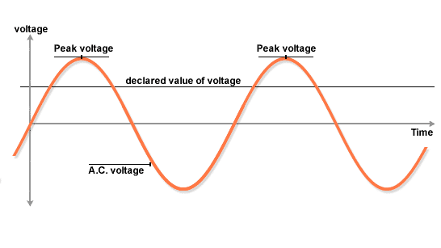
AC vs DC
AC = Alternating current
The electrons oscillate backwards and forwards, passing the electrical energy onwards but they themselves don’t move around the circuit.
http://australia.twig-world.com/films/war-of-the-currents-1544

Slide 53
Australian mains
Household mains power is 240V AC
AC alternates between peak values of 340V and -340V but gives equivalent power as 240V DC.

Slide 54
DC = direct current
Electrons flow in one direction only and they move around the circuit carrying the energy.
DC is a steady voltage.

Slide 55
Electric Shocks
Electricity has 3 effects on the human body:
Electrolysis which produces toxins.
Heating – body offers high resistance.
Stimulation of nerves. Nerves use electrical impulses to send signals. Can make muscles contract and ‘not let go’ and can stop heart beat and turn it into a fibrillation (shivering)

Slide 56
Electric Shocks
The quantity of current flowing through your body depends on:
Your electrical resistance
Dry = greater R, smaller I, (10-100 k ohm)
Sweaty/wet = less R, greater I (1 k ohm)
Connections to make a circuit or grounded.
The potential difference applied to your body by the source.
Time of connection affects damage done.

Slide 57
AC/DC Which is more dangerous?
a high enough current will kill regardless
AC may be more likely to stop your heart
DC more likely to prevent muscles from letting go
If a DC shock is survived may still die a few hours later
DC electrolyses body fluids creating toxic products inside the body

Slide 58
Current effects on the body
Current (mA) | Effect on the body if flowing for 0.5s
1 | Threshold of feeling
3 | Easily felt
10 | Painful
20 | Muscles paralysed – cannot let go
50 | Severe shock
90 | Breathing upset
150 | Breathing very difficult
200 | Death likely
500 | Serious burning, breathing stops, death inevitable

Slide 59
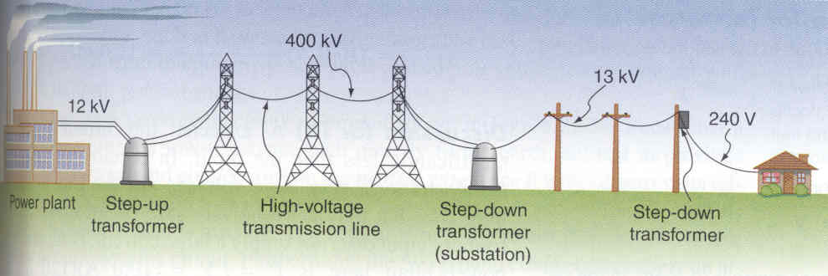
Transmission of electrcity
P_{loss}=I²R
P=VI
By transmitting power at high voltages it is possible to maintain the amount of power being transmitted but reduce the power loss by reducing the current

Slide 60
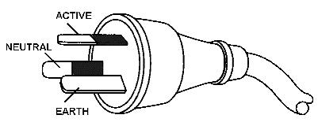
Three pin plugs
Completing a circuit requires two wires
Australian plugs sometimes have 3
Generally only need the third for devices with conductive housings

Slide 61
Typical Household circuit
Active wire:
Part of circuit
Provides the push and pull on the electrons
Rapidly alternates at 50Hz between roughly 340V and -340V
Creates an equivalent voltage of roughly 240V DC
Neutral wire:
Completes the circuit
Is earthed so at 0V
Earth wire:
Not part of the circuit
Creates a path to earth for appliance with metal cases
Safety feature
Active wire
Neutral wire
Earth wire

Slide 62
Typical Household circuit
Devices connected in parallel so they can be turned on and off independently
Active wire
Active wire
Neutral wire
Neutral wire
Earth wire
Earth wire

Slide 63
Short circuit
Short circuit completes circuit bypassing any load
R is greatly reduced
I is greatly increased
Causes heating of wires leading to fire
Active wire
Active wire
Short circuit
Neutral wire
Neutral wire
Earth wire
Earth wire

Slide 64
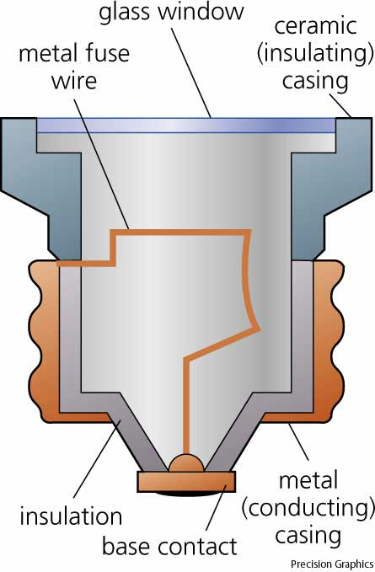
Fuses
A significantly higher current than normal is typically caused by a fault of some sort e.g. short circuit
Fuses prevent fires in such situations
Fuses are normally functioning wire at normal currents
If current is above safe level the fuse melts cutting the circuit
Different fuses for different purposes, always use correct fuse

Slide 65
Circuit breakers
Serves same purpose as fuse
Cuts circuit when current in circuit is too high
Not destroyed, no need to replace after tripping
Switch thrown by electromagnet if current becomes too high

Slide 66
Earth Wire
If active wire inside a device comes lose and touches the housing, the housing becomes live, anyone touching it can be electrocuted, completing the circuit through their body to the ground
Earth wire connects metal cases to the ground so if the case becomes live it immediately connects to the earth, causing a large current, throwing a circuit breaker or burning out a fuse

Slide 67
Double insulation
Alternative to earth wire
Make the case out of plastic
The active wire is contained in a plastic sheath (1st layer of insulation)
If the appliance case is also plastic (2nd layer of insulation) it is very difficult for a user to accidentally contact a live part connected to the active wire
Such devices do not need a 3rd pin on their power plug

Slide 68
Residual current devices (RCDs)
Compares current through active wire with current though neutral wire
During normal operation should be identical
If they are different there is most likely a fault (e.g. current flowing to ground through earth wire or a person)
The two wires are wound to create opposing electromagnets, if one is greater switch is thrown
Immediately (≈0.02s) cuts circuit

Slide 69
Twig: Safety in the home
http://australia.twig-world.com/films/electrical-safety-1542/

